Slide 1
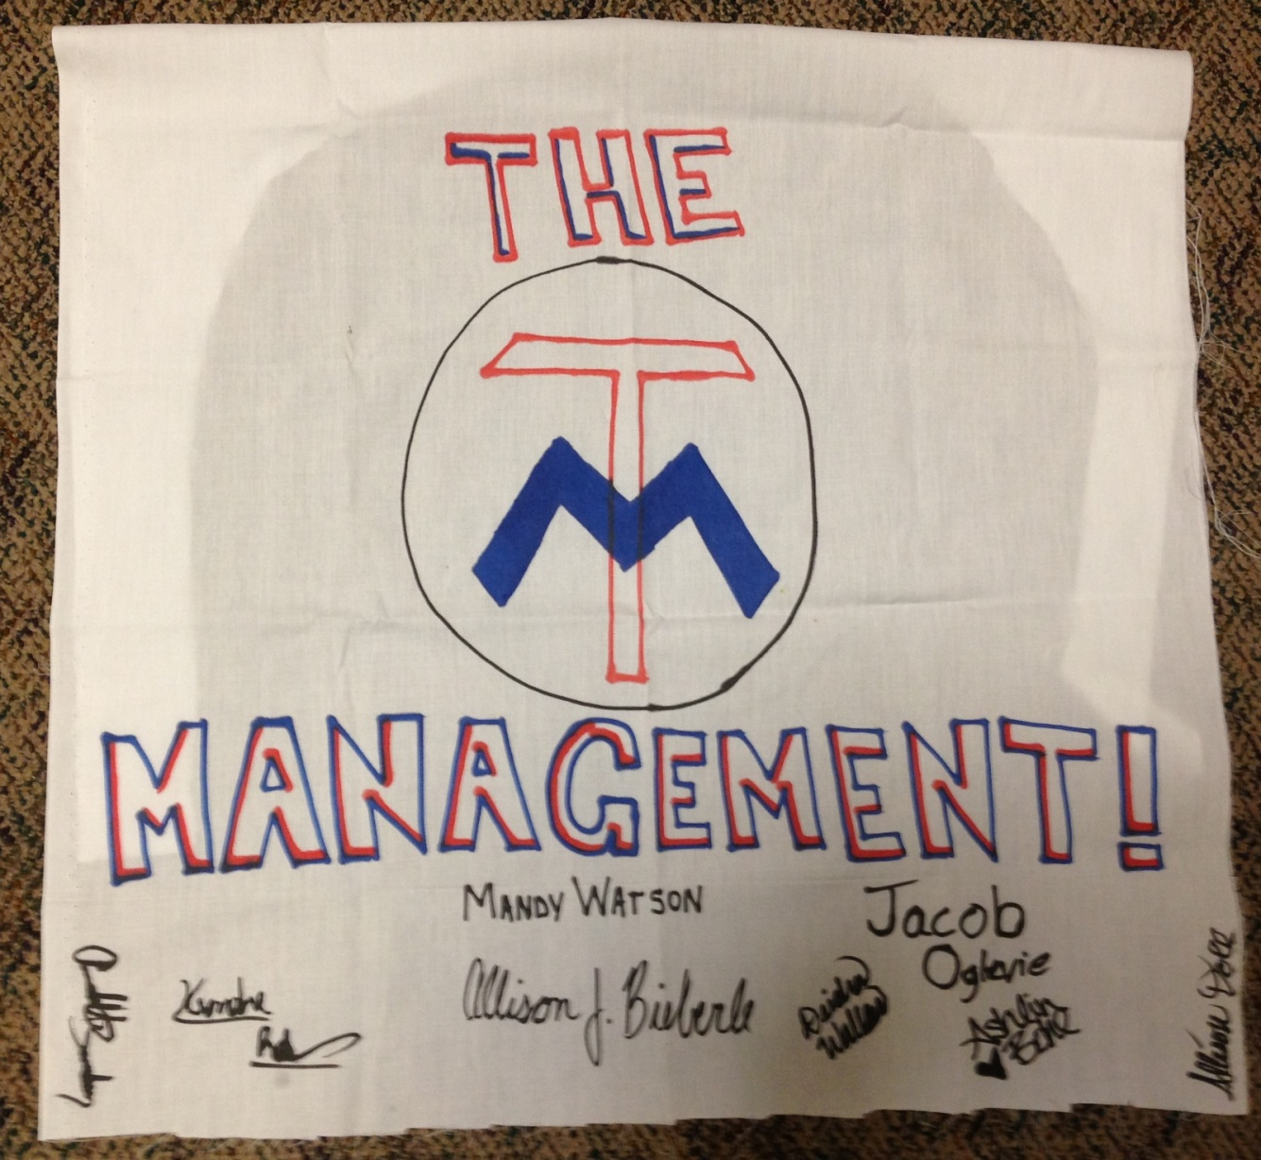
Team 2:
The Management
Mandy Watson
Allison Bieberle
Allison Doll
Annabell Sanchez
Ashlin Bohl
Keondre Robertson
Jacob Oglevie
Deidra Walker

Slide 2
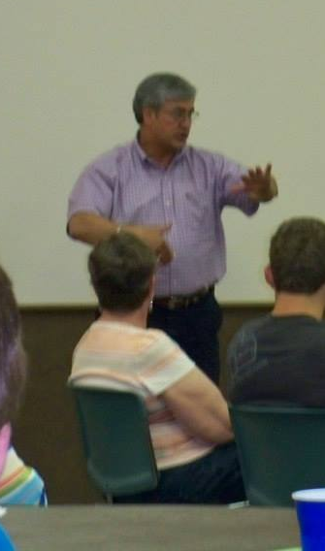
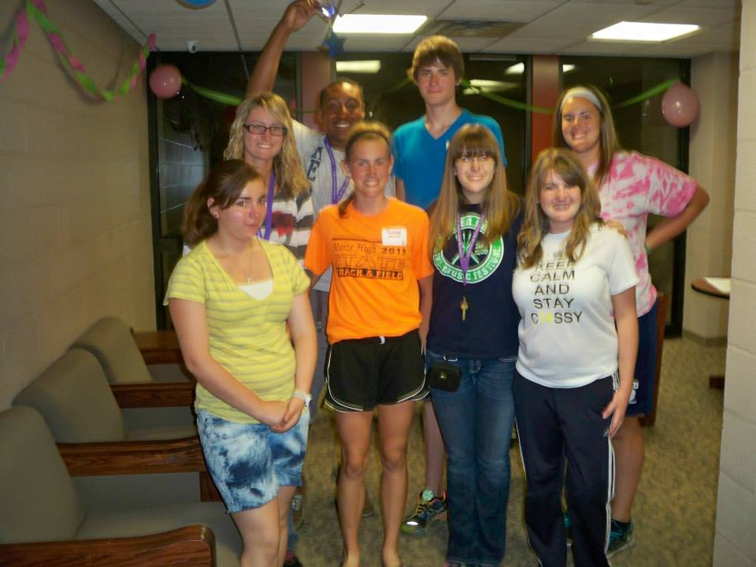
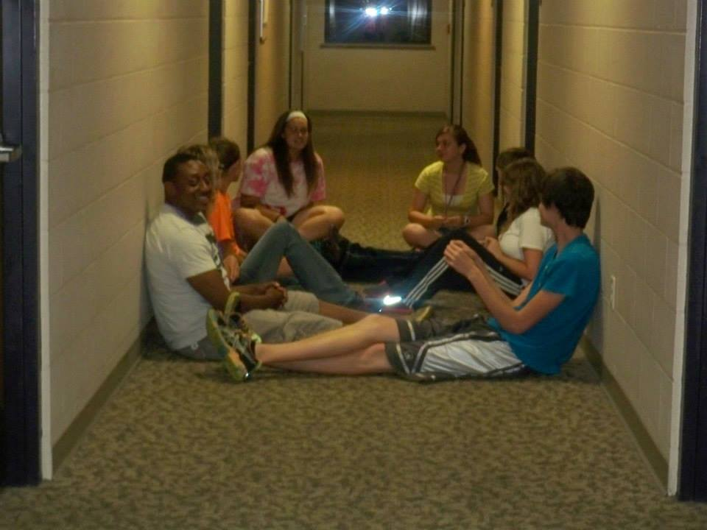
Getting to know you

Slide 3
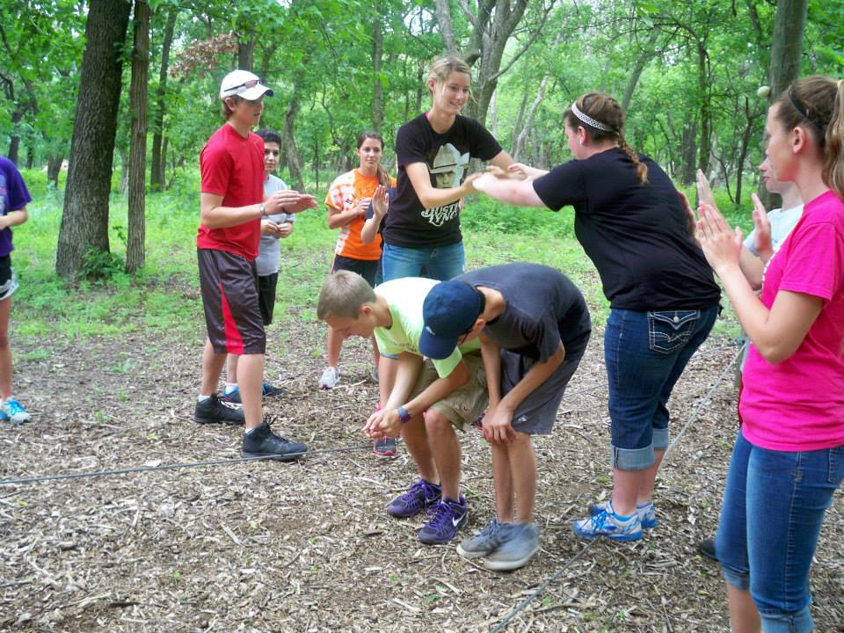
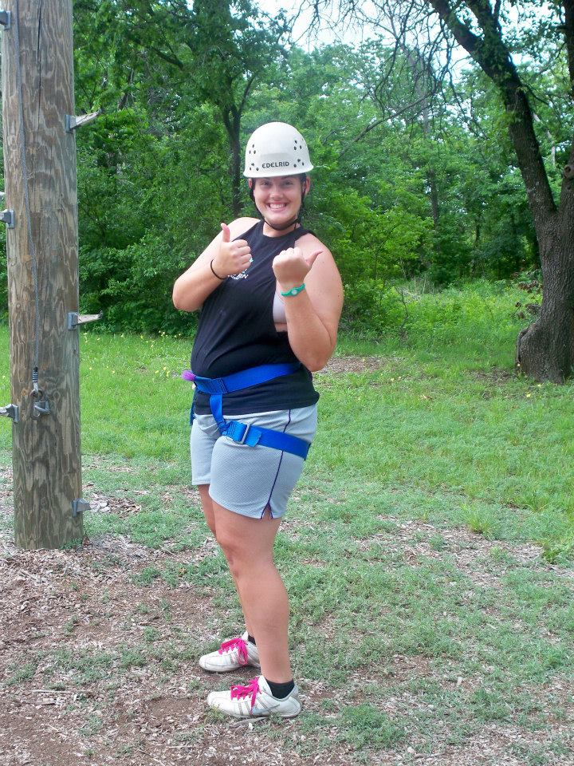
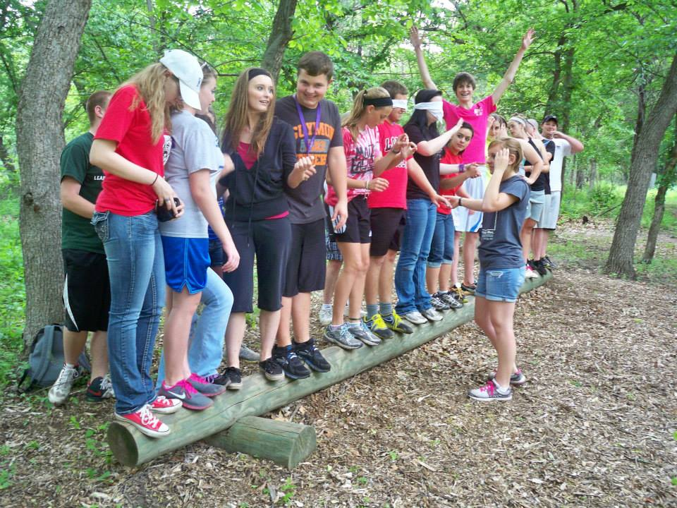
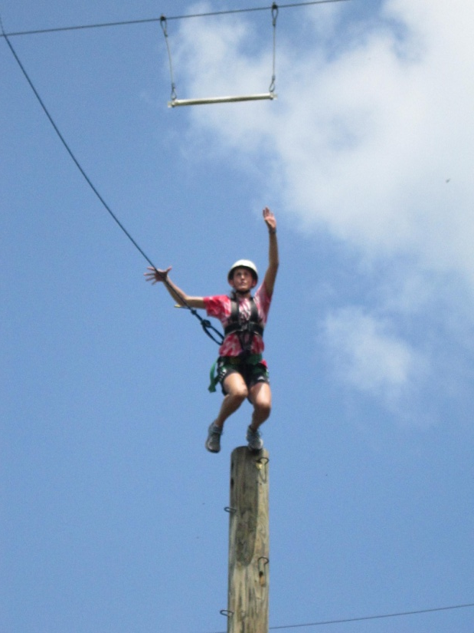
reaching new heights

Slide 4
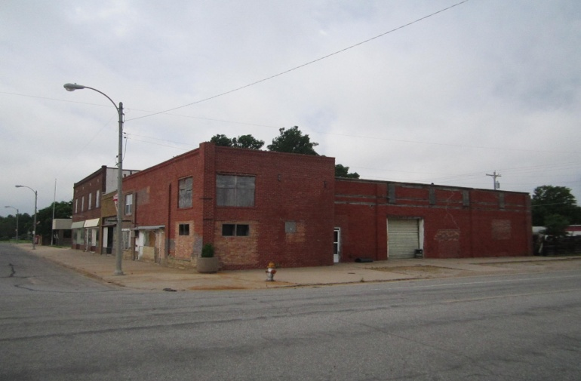
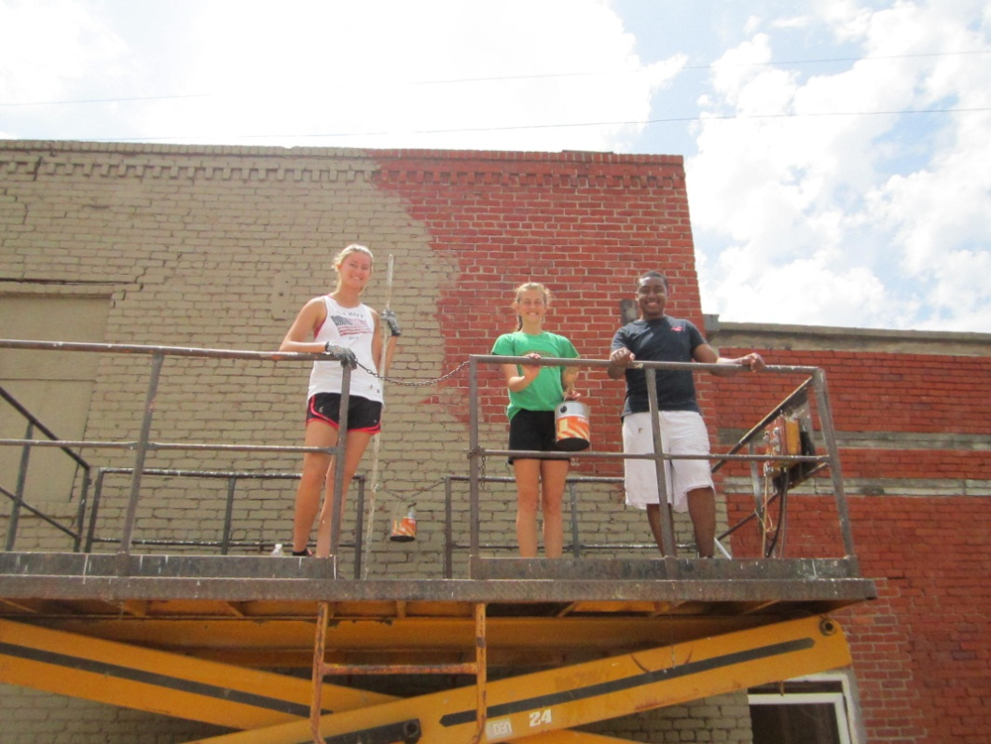
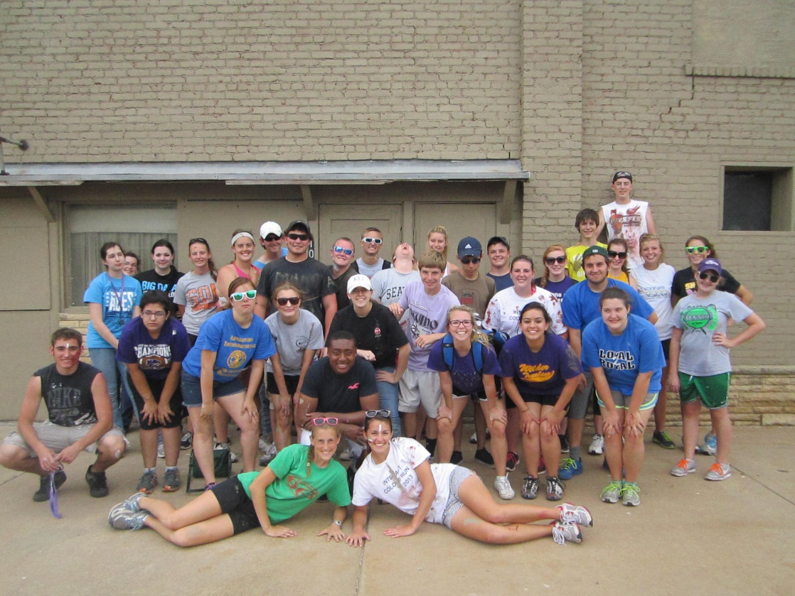
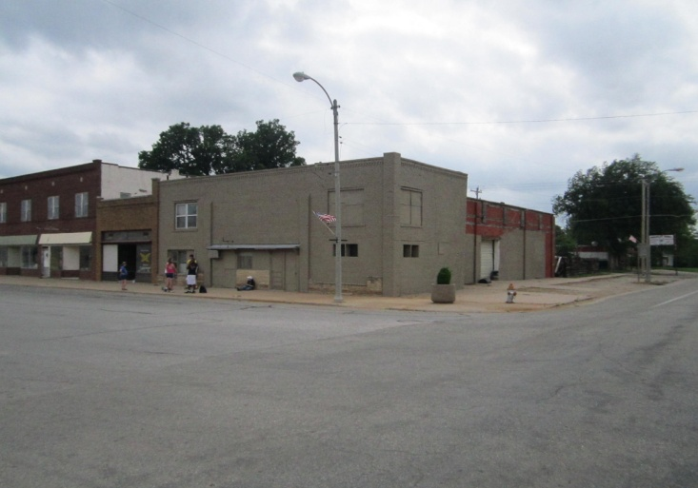
Serving others

Slide 5
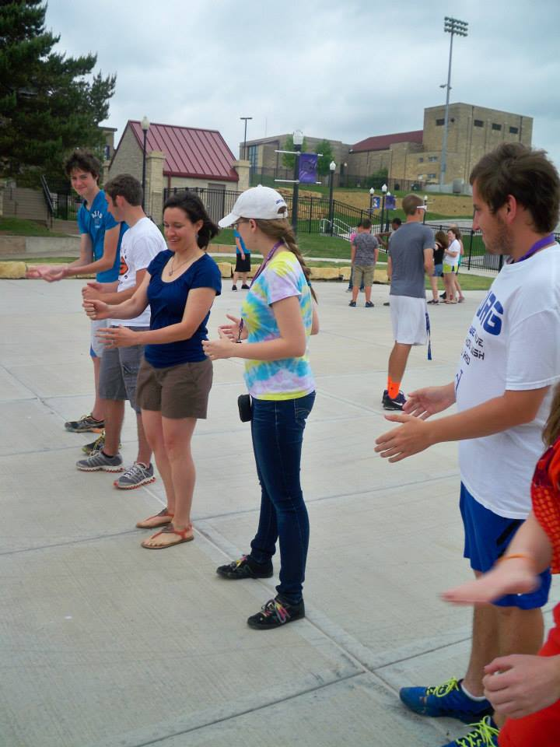
recognizing characteristics
    #1: Encouraging the Heart
  #2: Inspire a Shared Vision
  #3: Model the Way
  #4: Challenge the Process
  #5: Enable Others to Act
Notes:
1-Annabell, 2-Ashlin, 3-Deidra/Jacob, 4-Alli/Allison, 5-Keondre

Slide 6
Thank you!!!
Rotarians
Parents
Counselors/Directors
Southwestern College
SC staff
Everybody who made this possible!

Slide 7
