Slide 1
Simple Men
Simple Living, High Thinking

Slide 2
Our Starting Point of View

Slide 3
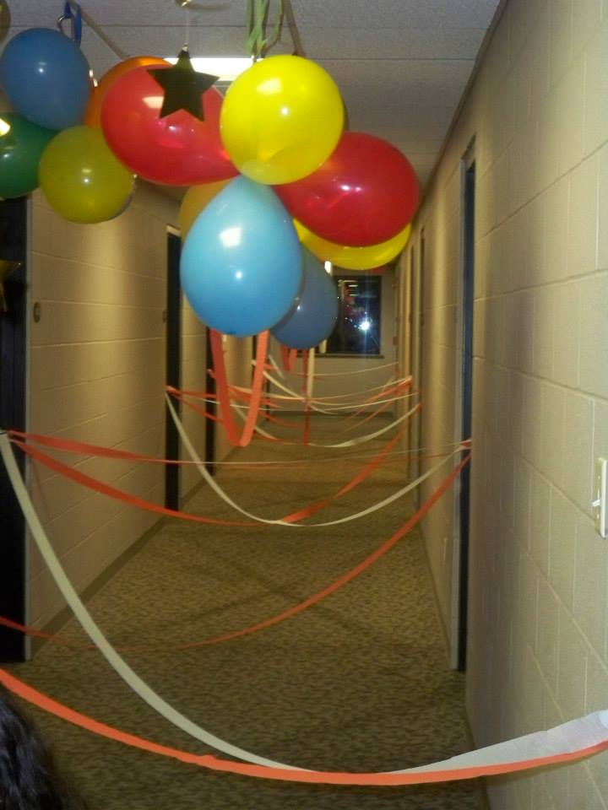
Inspire A Shared Vision
Effectively communicating to reach a common goal.
Activity: Legos
How can we take this back home with us?

Slide 4
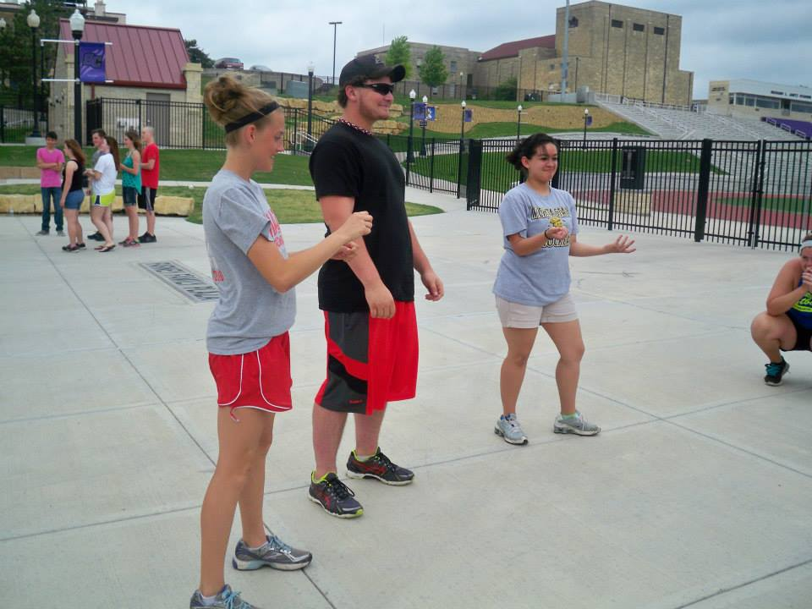
Model The Way
Leading by example
Activity: Charades
How can we take this back home with us?

Slide 5
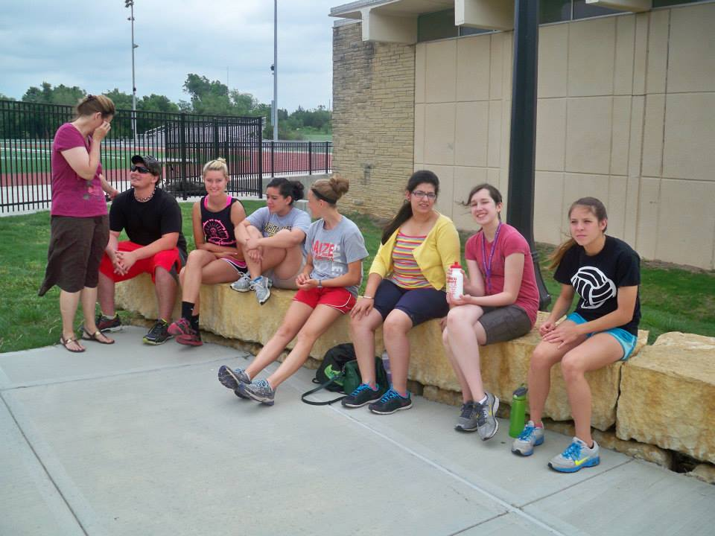
Challenge The Process
Don’t always take the easy way out
Activity: Tire Challenge
How can we take this back home with us?

Slide 6
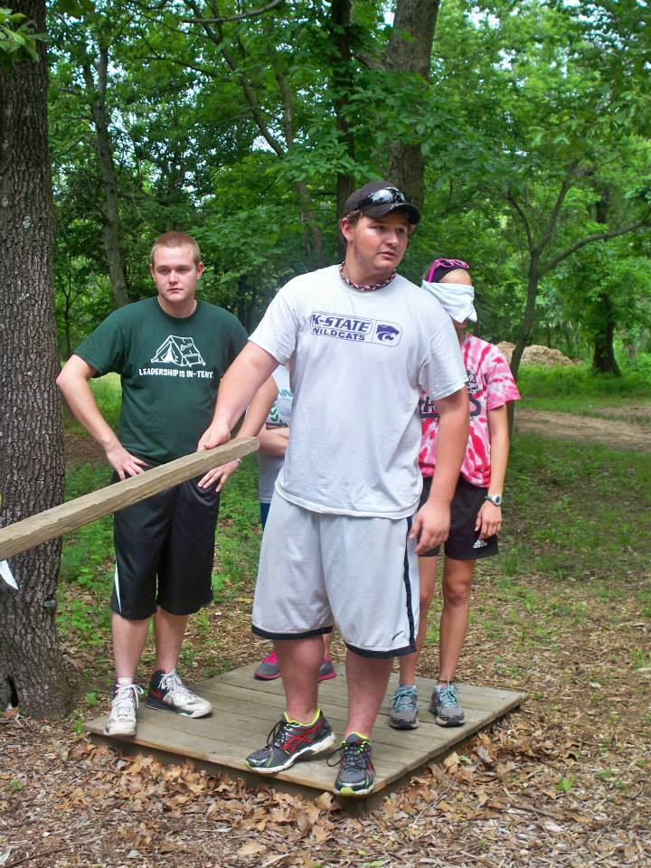
Enable Others To Act
Always try to get people involved
Activity: Making a model
How can we take this back home with us?

Slide 7
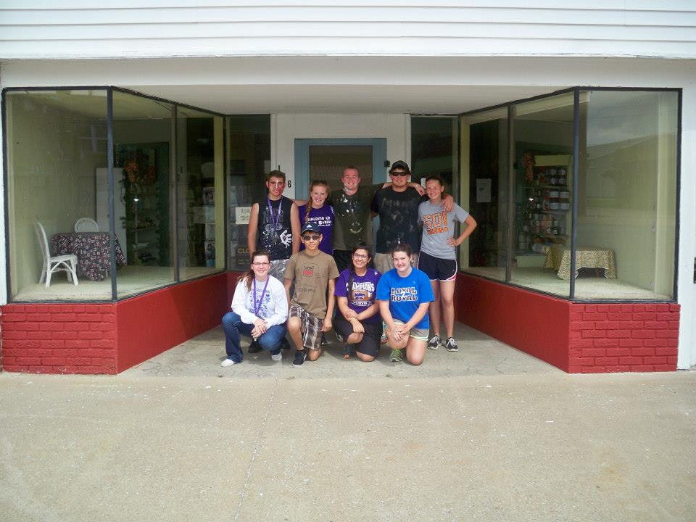
Encourage The Heart
Always support each others actions
Activity: A Questionnaire
How can we take this back home with us?

Slide 8
Challenges
Make it your goal to get to know 3 people personally.
Make it a goal to do something that is normally a struggle for you.
Make it a goal to live out servant leadership everyday.
Make it a goal to take something from this camp to your high school.

Slide 9
Ending Point of View

Slide 10
HAPPY BIRTHDAY, MICHAEL B #1

